Slide 1
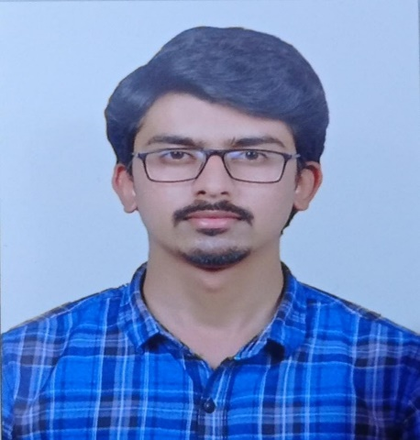
AKASH B M
Education and certificates
Adichunchanagiri Institute of Technology, Chikmagalur,Karnataka
2016-2021
Analyst/Software Engineer
Base Location: Mumbai
AKASH.A.B-M@CAPGEMINI.COM
+91-7975591471
Email ID: Mobile No: Grade: A4
Skills
Java
Java Basics, OOPS, Generics, Collections, Arrays.
Strengths
Spring Project
Arts and crafts academy admission portal
Framework
Spring Core, Spring Boot, Spring Data JPA, Spring Data REST.
Full Stack Development trained on Java Hands on experience on
Ars and crafts academy admission portal application is built to help customers to get ARTS & CRAFTS Academy Admission online.
Database
PostgreSQL, MongoDB
Git and GitHub.
MongoDB & PostgreSQL.
Core Java.
JPA with Hibernate.
Spring Framework.
HTML 5, CSS 3, Bootstrap, JavaScript
React.
React Project
Expense tracker
This application is built to help customer
Tools
Git, Postman, Visual Studio Code, Eclipse, PgAdmin 4.
to keep their
expenses updated. User can save,delete,update expenses, and it is easy to use.
Frontend
HTML, CSS, Bootstrap JavaScript, React
.

